Slide 1

Securing IoT Devices Utilizing Blockchain Research Paper
By: Jasmine Roberts
March 9, 2023

Slide 2

Introduction
Securing IoT Devices Data Utilizing Blockchain, means that the blockchain can scan, monitor, and collect its information just by its sensors.
IoT has been featured in many cyber-attacks, which consist of vulnerabilities within the device and itself.
Using Blockchain to secure your IoT device and its data, it can reduce your chance of such attacks, that can affect a single device or multiple that you own
While using Blockchain to secure your IoT device and its data, it is encrypted to where it is almost impossible to tamper into.
To correlate with the assigned topic (Securing IoT devices Data Utilizing Blockchain) of this document, there will be eight methodologies that are carefully researched, that will help secure your IoT device and its data
This Photo by Unknown Author is licensed under CC BY-SA-NC

Slide 3

Problem Statement
The technology in this century advances and expands, users have multiple devices within the IoT and its difficult to secure all of them.
Sometimes users aren’t aware of the security that is handed to them for free, or they won’t be interested in securing their device and data until a vulnerability happens.
There are many ways that you IoT device and its data can have a vulnerability without the proper security or encryption.
This Photo by Unknown Author is licensed under CC BY-SA-NC

Slide 4
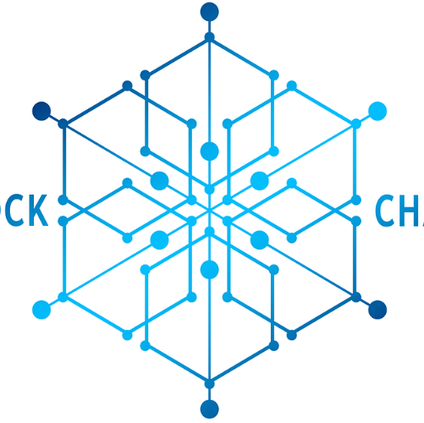
Literature Review
The state-of-the-art of using Blockchain to protect IoT devices and its data consist of its many techniques that is included with use and its implementations
Blockchain consist of Distributed Ledger Technology (DLT), Smart Contract, and Cryptographic Techniques
DLT consist of recording your information such as your financial banking information and transactions.
Smart Contract consist of carrying out you’re understanding in a form of agreement between stakeholder without the interruption of a third party.
Smart Contract consist of carrying out you’re understanding in a form of agreement between stakeholder without the interruption of a third party.
To correlate with the assigned topic (Securing IoT devices Data Utilizing Blockchain) of this document, there will be eight methodologies and ten artlices that are carefully researched, that will help secure your IoT device and its data using Blockchain
This Photo by Unknown Author is licensed under CC BY-SA-NC

Slide 5

Methodologies

Slide 6
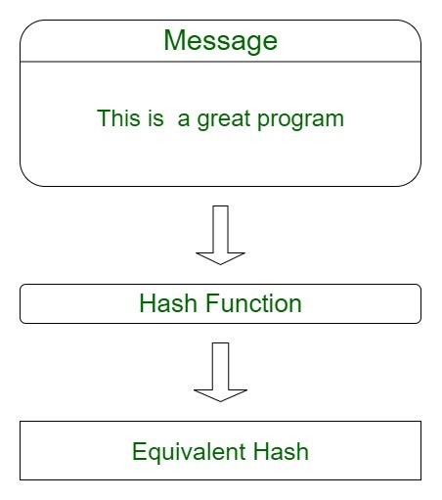
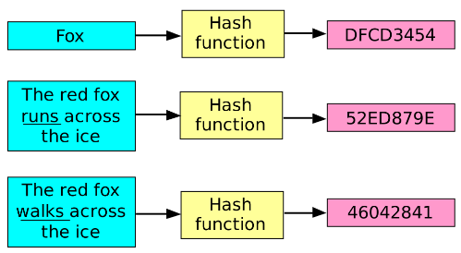
Method 1: Secured Hash Algorithm
Shortens your data inside of your IoT device into a smaller form that can’t be understood by using operations, and compressed functions
Its like encryption, which cannot be cracked unless a hacker is using Brute Force
There are only two types of SHA forms which is SHA-1 and SHA-2.
Acts as an authentication mechanism for IoT devices and its data.
If you are a sender within your device, a unique hash code will be generated for the data that is about to be sent. Its hash code will act as an authentication token for the transaction of the data.
It acts like an application to encrypt passwords and data as the server’s side which would only keep track of a specific user’s hash value, rather than the actual password.

Slide 7
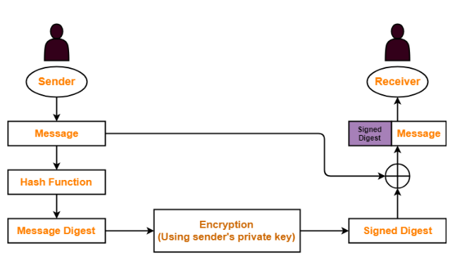
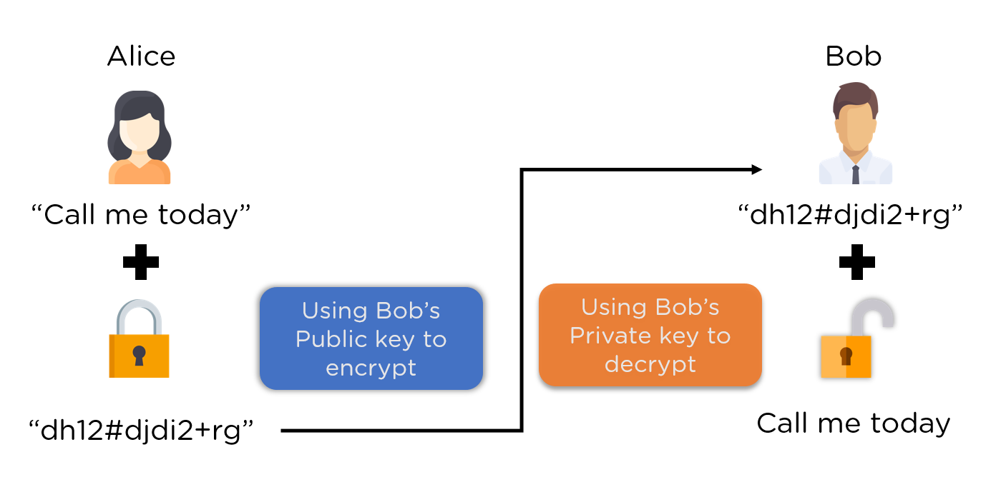
Method 2: Digital Signature Algorthim
It is used to authenticate and verify data
It can maintain the authenticity and integrity of your documents to hold your private information on your IoT device.
Within the Digital Signature it is eencrypted using the private key and decrypted with the public key.
Based on cryptography and used to identify the sender or the signer, to ensure that the original content of the message/data is unchanged.
There are five ways that Digital Signature can help secure your IoT device and its data by Ensuring Authenticity, Offers Non-repudiation, Provides Secuirty, Improves Efficiency, and Enhance Compliance.

Slide 8
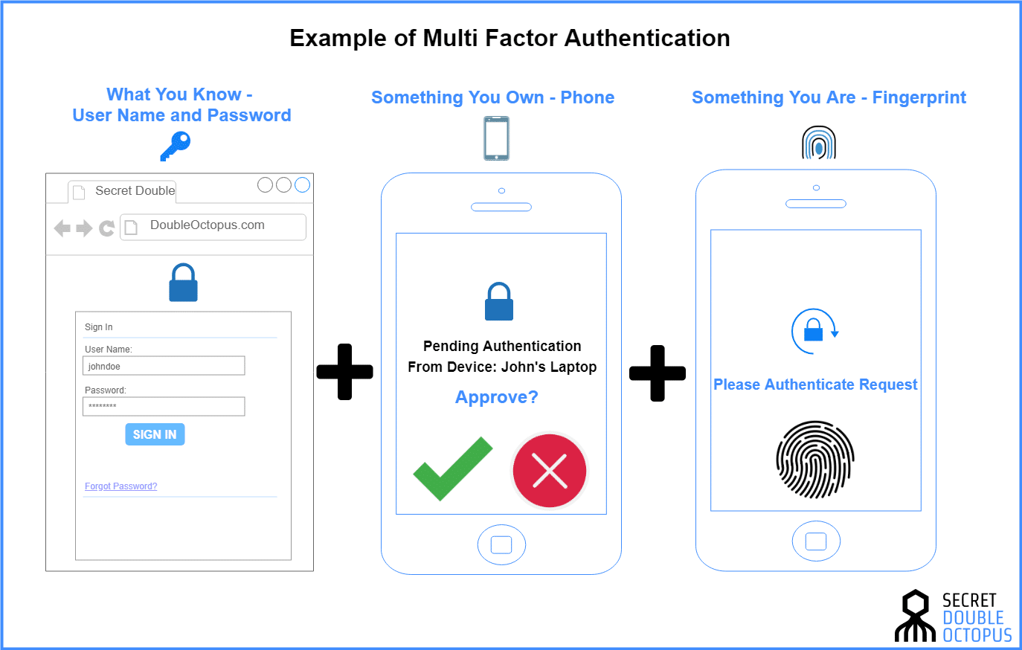
Method 3: Multi-Factor Authentication
Is a method that the requires the user to provide two or more verification factors to gain access to an IoT device
Its most common factor is the one-time password such as 4–8-digit codes that you receive most inside of your email, and SMS.
The code is generate based upon a “seed” value that is assigned to the user when they first register.
Besides the SMS Message authentication there many other types, such as Username and password entered, and a Fingerprint

Slide 9
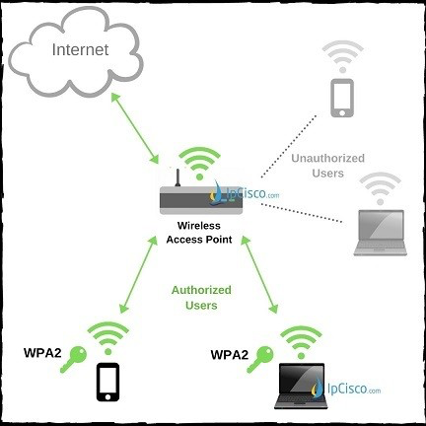
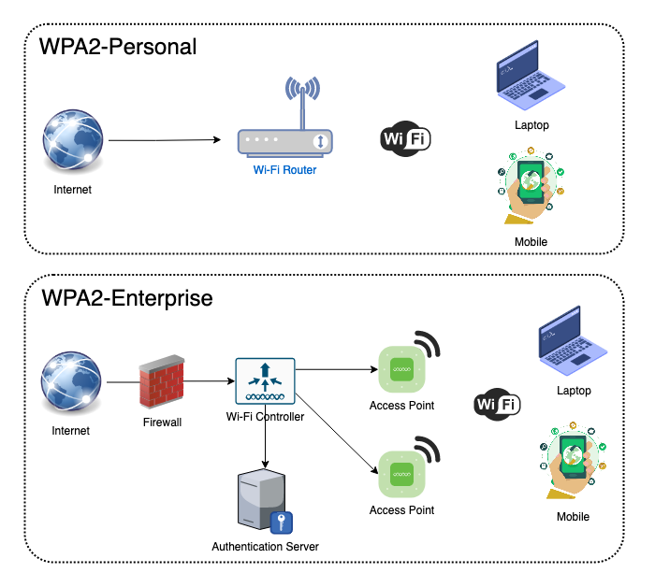
Method 4: WPA2 (Wi-Fi Protected Access 2)
WPA2 is acronym for Wi-Fi Protected Access 2 which is the second generation of Wi-Fi protected access wireless security protocol
WPA2 provides the top security and an encryption upgrade, which would be considered for IoT devices
While using your IoT device while connected to WPA2, hackers may see your data traffic but it will be scrambled enough by encryption to provide security.
WPA2 is based on a robust security network mechanism, which mean that it is an enhancement for security.
WPA2 has two off -springs such as WPA2-PSK (Personal mode or Pre-Shard Key), and WPA2-ESP ( Enterprise Mode).

Slide 10
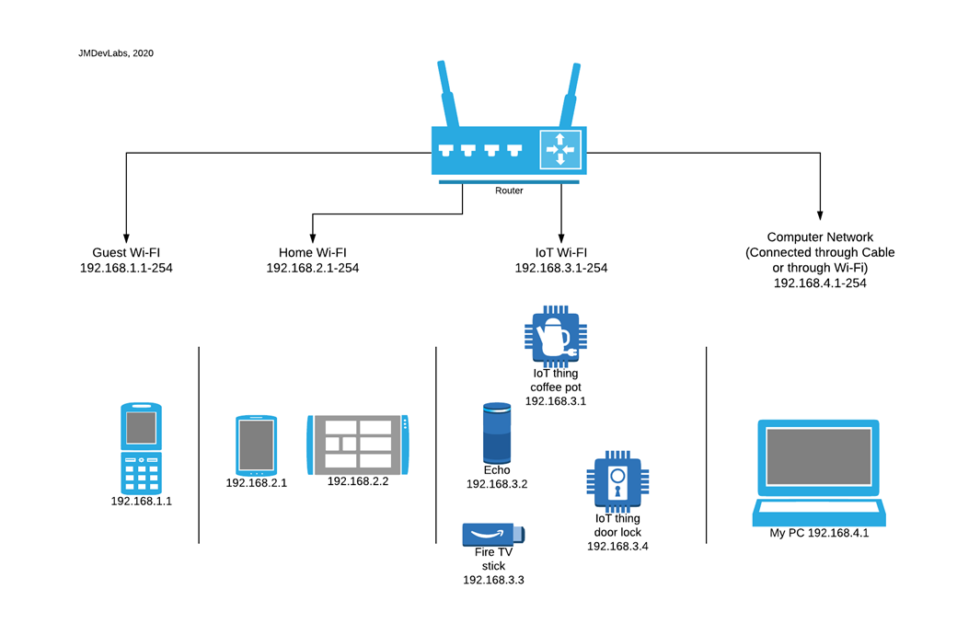
Method 5: Create a separate Wi-Fi for IoT Devices
Can help secure your device and its data by improving security and cutting losses with hackers that are targeting IoT devices that is usually on the same network
When you sperate networks a hacker cannot see everything at the same time, if something ever becomes breached, they will never know that you have a IoT device and that is because they would be on a separate network
A separate Wi-Fi would consist of a Guest Wi-Fi network.
When adding new devices to your network make sure you are adding them to the proper network (existing network or Guest network) to keep the security effective.

Slide 11
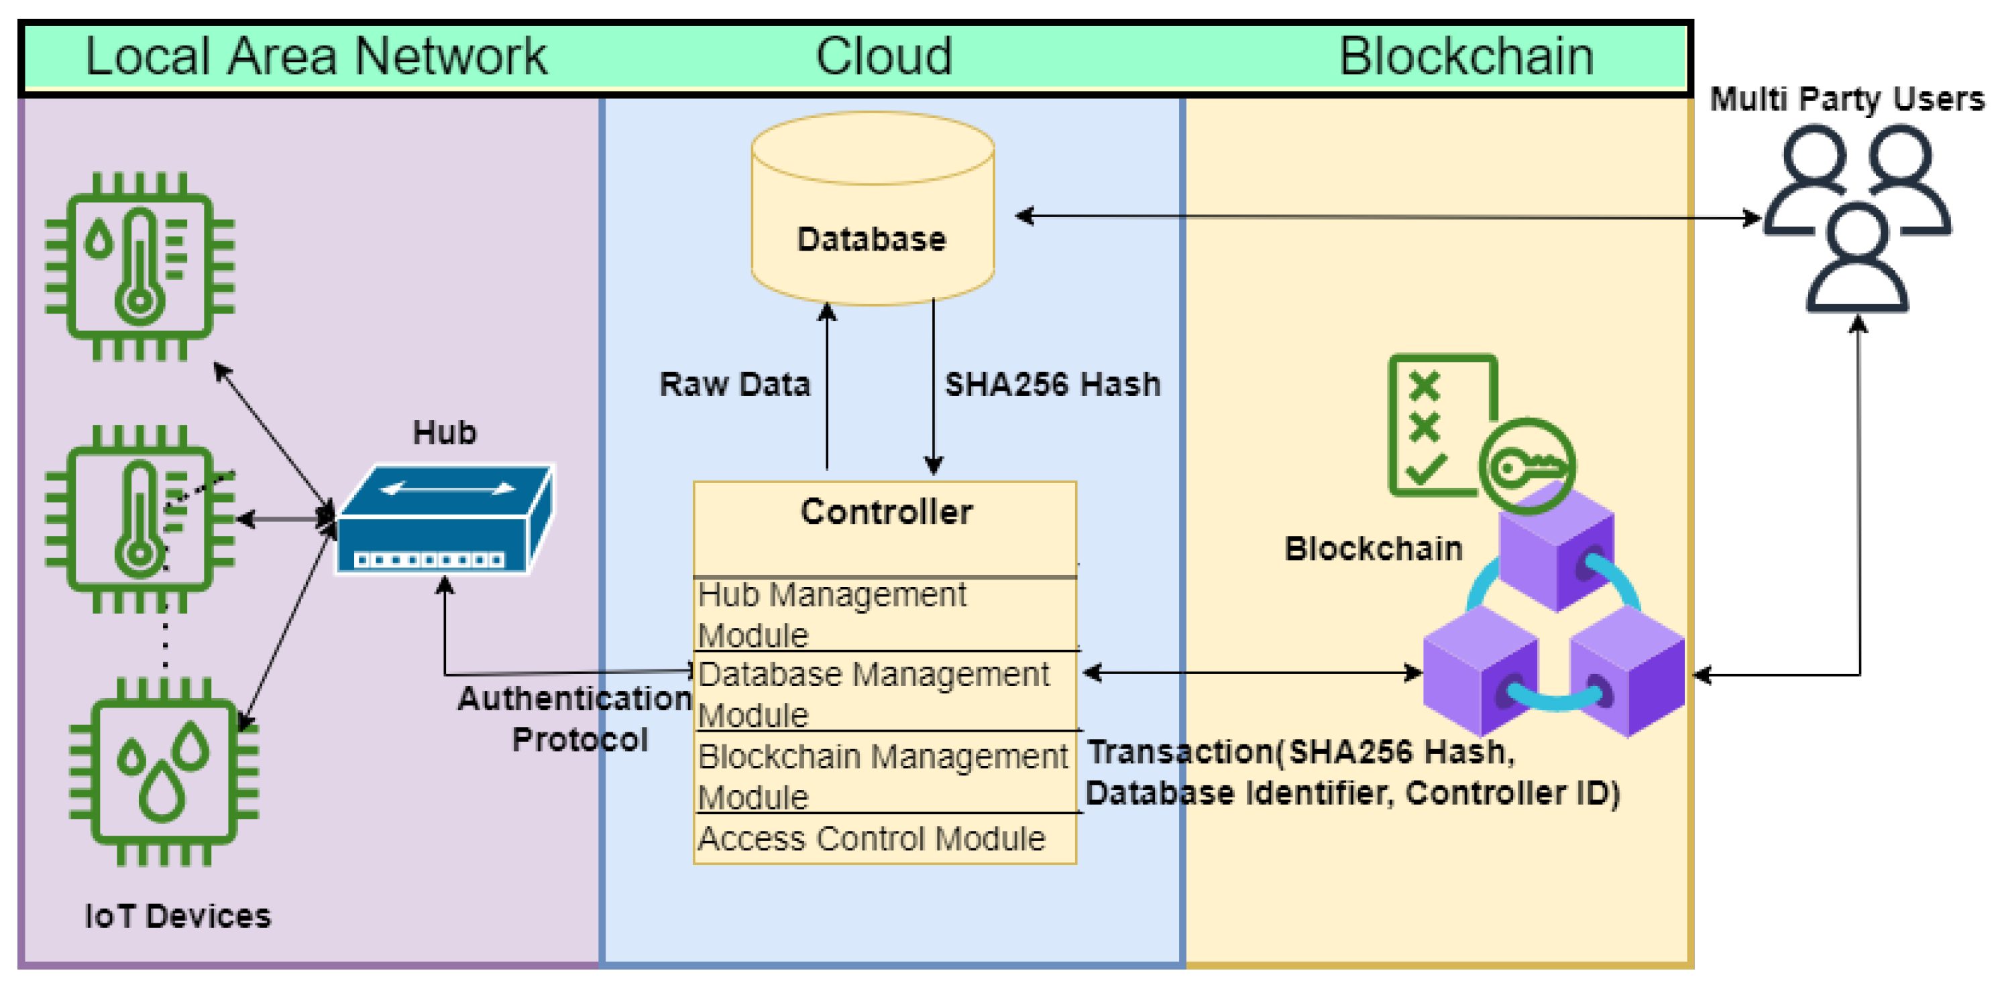
Method 6: Blockchain
Blockchain will distribute the digitally signed data and will retract any changes made within, which can be traced back
Blockchain will provide an additional layer of security that hackers would need to bypass to get access to your IoT device and its data
Blockchain uses cryptography to keep your data secure and inside of its blocks from unauthorized user’s and vulnerabilities
Cryptographic techniques include a user’s authentication and validation of any transactions, and tamper proof chain of blocks.

Slide 12
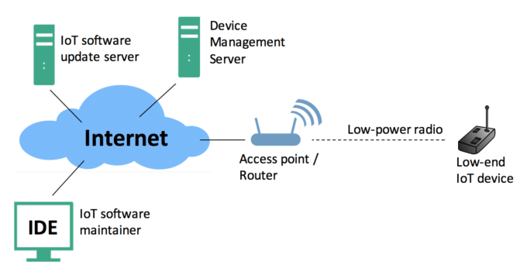
Method 7: Keep Firmware Updated
Can help maintain its functionality and minimize hacker risk
If your device’s Firmware isn’t up to date, you are putting yourself at risk of a negative impact
Firmware can include but not limited to bug fixes, security updates, new features, and technology changes.
Hackers would attempt to access the Firmware itself because it is usually the first step to reach personal creditable.
Hackers would also try to hack the Firmware itself because it has software libraries, and configurations settings.

Slide 13
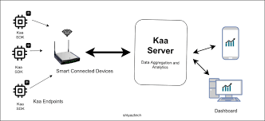
Method 8: KAA IoT Platform
KAA is a multi-purpose, free and open-source platform for implementing end-to-end IoT solutions, connected application, data, and smart products
You can manage the device, collect, and monitor its data
To use KIAA you must first connect your IoT device of your choice with HTTP. Next, collect and monitor the data, send commands to the device

Slide 14
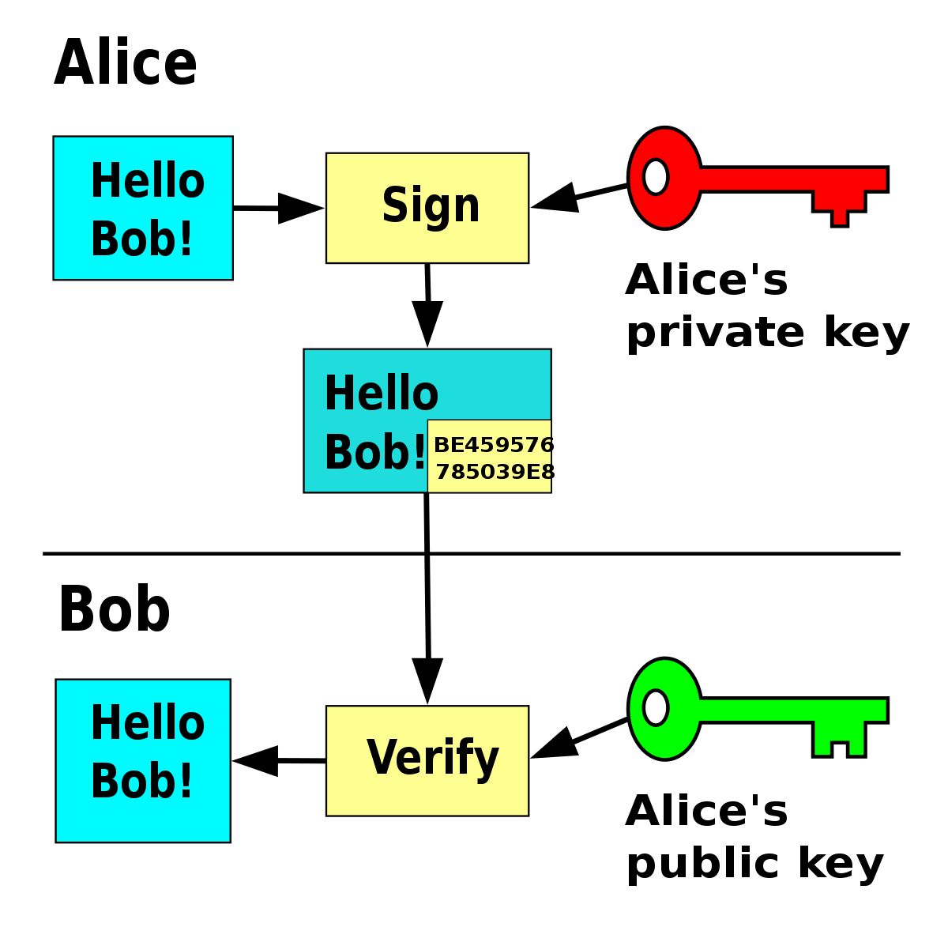
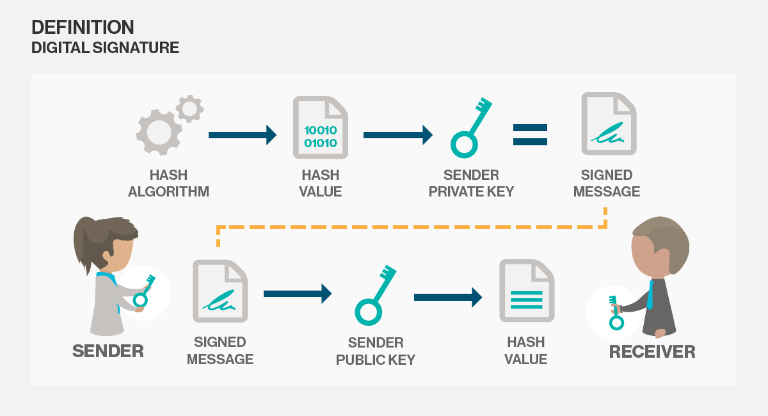
Most Effective Method: Digital Signautre
It is a great way to authenticate data over the internet.
Provides encryption algorithms to protect the device and data from authorized access and tampering.
The signature is based on cryptography and used to identify the sender or the signer, to ensure that the original content of the message/data is unchanged.
Digital Signatures can also protect confidential information and ensuring that only authorized users can access the data.
It can maintain the authenticity and integrity of your documents to hold your private information on your IoT device.

Slide 15
Refernces
Works Cited
Arampatzis, A. (2021, August 23). Secure Firmware Updates Are A Necessity for Resilient IoT Deploments. Retrieved from Venafi: https://securithings.com/blog/why-iot-firmware-updates-for-physical-security-devices-are-mission-critical/#:~:text=Should%20IoT%20devices%20always%20be,risks%2C%20and%20eliminating%20compliance%20bottlenecks.
Block Chain: The Missing Link Between Secuirty and IoT? (2018, May 17). Retrieved from TREND MICRO: https://www.trendmicro.com/vinfo/mx/security/news/internet-of-things/blockchain-the-missing-link-between-security-and-the-iot
Breck, C. (2020, December 6). The State of the Art for IoT. Retrieved from Colin Breck: https://blog.colinbreck.com/the-state-of-the-art-for-iot/
Chakray. (n.d.). Retrieved March 2023, from Blockchain and IoT Secuirty: Everything you need to know: https://www.chakray.com/blockchain-iot-security/#:~:text=For%20IoT%20safety%2C%20the%20blockchain,for%20a%20trusted%20third%20party.
Ghimiray, D. (2022, January 7). Wi-Fi Secuirty: WEP vs WPA or WPA 2. Retrieved from Digital Life: https://www.avast.com/c-wep-vs-wpa-or-wpa2
Home Secuirty. (n.d.). Retrieved March 2023, from Dual Layer: IT Solutions LTD: https://www.duallayerit.com/home-security-why-you-should-put-iot-devices-on-a-guest-wi-fi-network/#:~:text=By%20putting%20all%20your%20IoT,(computers%20and%20mobile%20devices).
Jena, B. K. (2023, February 14). Digital Signature Algorthim (DSA) in Cryptography: How it Works & More. Retrieved from Simpli learn: https://www.simplilearn.com/tutorials/cryptography-tutorial/digital-signature-algorithm
KAA. (n.d.). Retrieved March 2023, from Start building your solution with KAA Enterprise IoT Platform: https://www.kaaiot.com/
Landman, N. (n.d.). Secure Hash Algorithms. Retrieved March 2023, from BRILLIANT: https://brilliant.org/wiki/secure-hashing-algorithms/
Niazi, R. (2022, March 11). Intorudction to Digital Signature Algorithm (DSA). Retrieved from Make Use Of (MJO):
https://www.makeuseof.com/introduction-to-digital-signature-algorithm/
Parizo, C. C. (2023, March 3). What are the 4 different types of blockchain technology? Retrieved from Tech Target | CIO: https://www.techtarget.com/searchcio/feature/What-are-the-4-different-types-of-blockchain-technology#:~:text=There%20are%20four%20main%20types,benefits%2C%20drawbacks%20and%20ideal%20uses.
Phillips, G. (2022, November 8). WEP vs. WPA vs. WPA2 vs. WPA3: Wi-FI Secuirty Types Explained. Retrieved from MJO: Make use of : https://www.makeuseof.com/tag/wep-wpa-wpa2-wpa3-explained/
Quigley, J. (2021, April 6). How Does Blockchain Secure Credentials? Retrieved from Accredible: https://www.accredible.com/blog/how-does-blockchain-secure-credentials#:~:text=Data%20that%20is%20written%20to,with%20the%20correct%20decryption%20key.
Saurabh, S. (2019, October ). How Blockain Will Help IoT Become More Secured. Retrieved from Wipro: https://www.wipro.com/communications-/how-blockchain-will-help-iot-become-more-secured/
Shrimali, B. (2022, October 9). Blockchain state-of-the-art: architecture,uses cases,consensus,challenges and opportunities.
Retrieved from Science Direct: https://www.sciencedirect.com/science/article/pii/S131915782100207X
What is Multi-Factor Authentication and How Does it Work? (n.d.). Retrieved March 2023, from OneLogin by One Identity: https://www.onelogin.com/learn/what-is-mfa#:~:text=Multi%2Dfactor%20Authentication%20(MFA)%20is%20an%20authentication%20method%20that,online%20account%2C%20or%20a%20VPN.
What is SHA? What is SHA Used For? (n.d.). Retrieved March 2023, from Encrytion Consulting: https://www.encryptionconsulting.com/education-center/what-is-sha/#:~:text=SHA%20stands%20for%20secure%20hashing,modular%20additions%2C%20and%20compression%20functions.
Why IoT Firware Updates for Ohysical Secuirty Devices Are Mission-Control. (n.d.). Retrieved March 2023, from SecuriThings: https://securithings.com/blog/why-iot-firmware-updates-for-physical-security-devices-are-mission-critical/#:~:text=Should%20IoT%20devices%20always%20be,risks%2C%20and%20eliminating%20compliance%20bottlenecks.

